Slide 1
READY

Slide 2
Principles and Conservation Values of
Ethiopian Orthodox Tewahido Church (EOTC)
.
The Case of Debrelibanos monastery
.
Thesis submitted to the Graduate Programs Director of the Ethiopian Institute of Architecture, Building Construction and City Development (EiABC), Addis Ababa University, in partial fulfillment of the requirements for the Masters of Conservation of Urban and Architectural Heritage
.
Yohannes Mekonnen
June, 2018

Slide 3
  Introduction
  Definition, Heritage
  Old French word “heriter” which means “inherit” is the origin of the word Heritage.
  dictionary meaning
  “Property that is or may be inherited; an inheritance”, “valued things such as historic buildings that have been passed down from previous generations”, and “relating to things of historic or cultural values that are worthy of preservation”.
  (Oxford English Dictionary)

Slide 4
  Introduction cntd…
  Heritage Forms
    Tangible heritages, like objects and artifacts
    Intangible heritages, Religious or cultural rituals and celebrations
  For the sake of this research Heritage might be understood as a physical object and Building, religious or cultural spaces which have historic integration with human cultural practices or sacraments, that is worthy of being conserved or inherited, which has cultural value and can be owned and passed on from one generation to another.

Slide 5
  Introduction cntd…
  Definition, Conservation
Burra Charter (Article 1.4) conservation is defined as;
“all the processes of looking after a place so as to retain its cultural significance which encompasses the activities that are aimed at the safeguarding of a cultural resource so as it retains its historic value and extends its physical life”.
(ICOMOS 1999)

Slide 6
  Introduction cntd…
  Statement of the Problem.
  There has been growing criticism about Eurocentric in global conservation practices.
  Heritage conservation has also been defined differently in different countries based on countries specific values and traditions.
  Venice Charter of European values were adopted as the ethical guideline for ICOMOS
  Due to lack of understanding of the underplaying values of living religious heritages of EOTC, conflicts arise in several conservation and development projects of the country.

Slide 7
  Introduction cntd…
  Research Questions
  The goal is to identify values of religious sites from EOTC perspective and to identify challenges of its conservation
What are the underlying church conservation values and principles of EOTC ?
To what extent are the international values of conservation responsive to religious heritages of EOTC?
What are the priorities in Conservation of LRHS of EOTC?

Slide 8
  Introduction cntd…
  Research Objectives
  Identifying values related to decision making on conservation
  Identifying values related to conservation design preparations
  Identifying values related to Conservation work management
  Identifying values related to Material selection for actual conservation
  Identifying universally accepted values vs EOTC’s accepted norms

Slide 9
  Introduction cntd…
  Importance of the Research
  To identify the underplaying values of EOTC in conserving LRHS.
  To decide what approach or principle to adopt while conserving EOTC monasteries.
  To provide insight in developing the most appropriate approaches in tackling challenging problems of heritage protection and generating understanding and mutual respect.

Slide 10
  Introduction cntd…
  Research Scope and Limitations
  Scope
    This research focuses on identifying conservation principles and values for the conservation of Ethiopian Orthodox Tewahdo Church, based on the case of Debrelibanos Monastery.
    The scope also limited to analyzing quantitative data collected from purposively selected respondents and archival analysis.

Slide 11
  Introduction cntd…
  Research Scope and Limitations
  Limitations
    Limited number of population who can be qualified to participate for the need.
    Hesitation and lack of awareness of some of clergy men
    luck of similar indigenous case studies.
    Lack of compiled historical data of reconstruction and conservation of EOTC monasteries.

Slide 12
LITERATURE REVIEW
  Heritage Conservation
  Advancement of modern society.
  The definition of objects and structures of the past as heritage.
  Growth of policies related to heritage protection, restoration, and conservation.
  Deterioration, including weathering, the ageing process, and consumption by users.

Slide 13
  Literature Review cntd…
  Principles, Traditions and theories of conservation.
  Tradition Of The West
  Rooted on the western culture associated only with tangible qualities (Euro centric)
  Evolved from the pressures imposed on the historical centers of the cities due to rapid pace of urban growth and change
  The industrializations, population pressures, new developments
  Object based (upon soft science) and Aesthetics (based the hard material science)

Slide 14
  Literature Review cntd…
  Principles, Traditions and theories of conservation.
  Tradition Of The East
Rooted from the Asian tradition of conservation.
Conserving by reconstructing replica.
In the end of the twentieth century, the shift from object oriented to subject oriented conservation tradition.
Acknowledged the plurality of meanings, functions and values for the same object of conservation for different people.

Slide 15
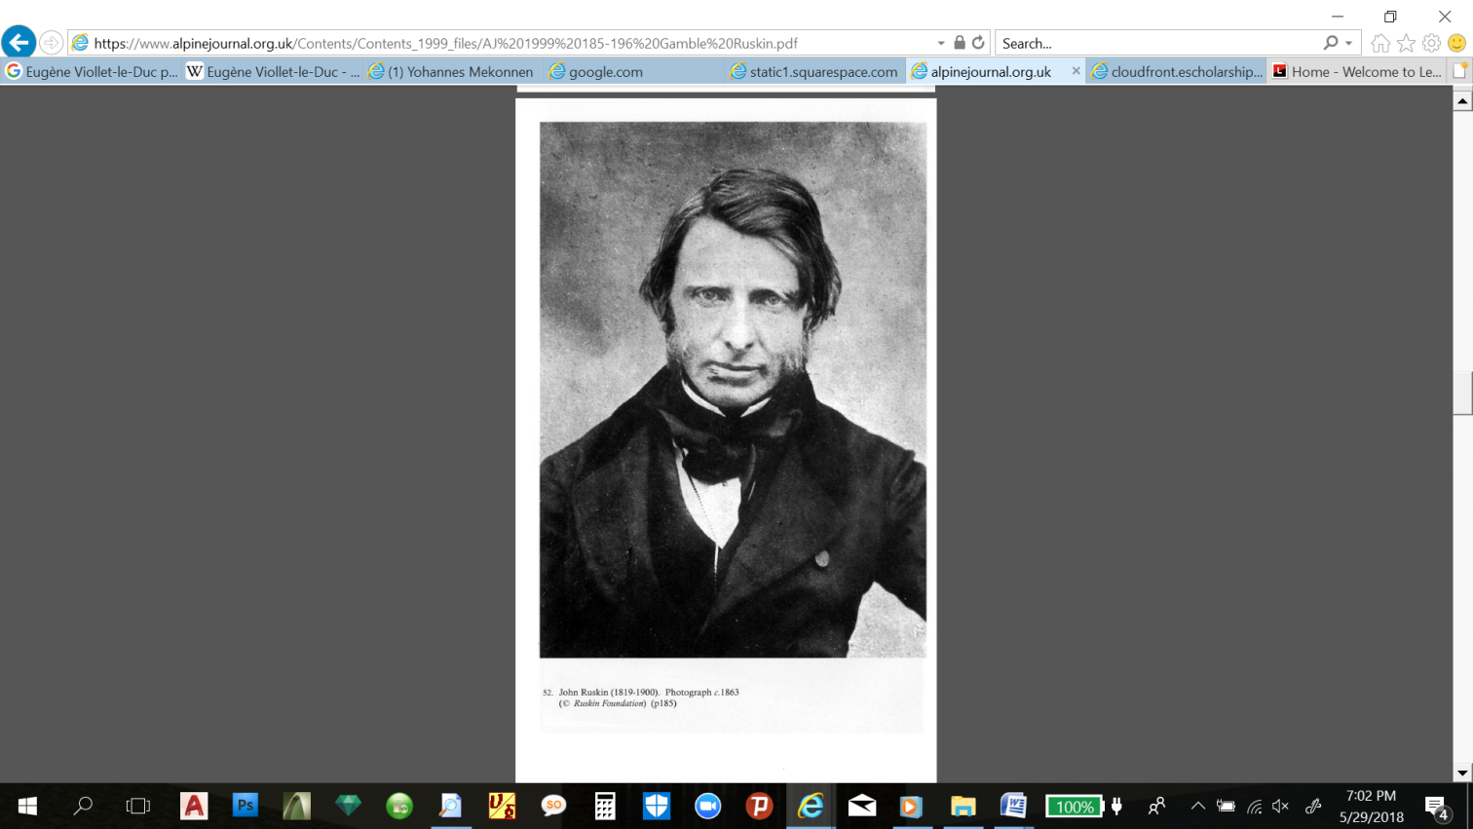
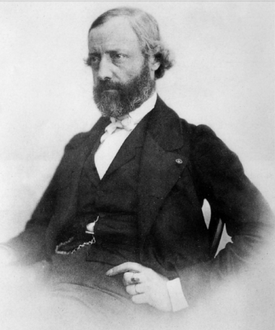
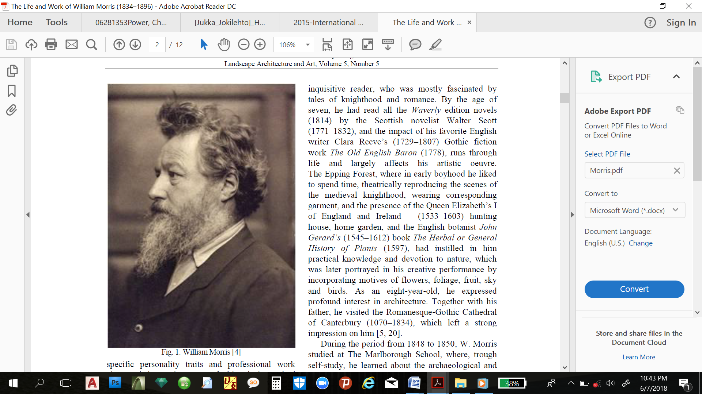
  Literature Review cntd…
  Principles of conservation.
`
John Ruskin (1819–1900) “Truth and memory” | Emmanuel Viollet-le-Duc (1814-1879) "unity of style” | William Morris (1834–1896) Conservative repair

Slide 16
  Principles of conservation cntd…
John Ruskin
“Truth and memory”
  French architectural historian and theorist
  Known for his book, The Seven Lamps of Architecture, and it was written to analyses the significance of Architectural Conservation.
  He used to document old cathedrals architectural designs
  He opposes imitations, building materials and working methods must be honestly what they appear, and the creator’s intention was essential
  he promoted traditional workmanship
  Truth and honesty are Ruskin’s Principles of Conservation.

Slide 17
  Principles of conservation cntd…
Emmanuel Viollet-le-Duc
"unity of style”
  French architectural historian and theorist
  Reformulated concept of "unity of style”
  initial aim was to restore in the style of the original
  often added entirely new elements of his own design
  borrowed and "modern" architectural elements in order to create a homogenous whole that never really existed.
  "unity of style” was adopted as a basic principle at The Sixth International Congress of Architects held in Madrid in 1904:

Slide 18
  Principles of conservation cntd…
William Morris
“Conservative repair”
  He learned about the archaeological and sacred architectural industries and Theology.
  Drafted for the new society (SPAB) a Manifesto, which gives a strong condemnation of modern restoration as arbitrary.
  Everything made by human hands had a form, either beautiful or ugly. ‘Beautiful if it is in accordance with nature, and ugly if it is discordant with nature
  emphasizing the value of work, satisfaction with the mastery of hand skills and the natural aesthetics of the raw material.

Slide 19
  Theories of conservation.
Classical Conservation Theory
Views the original material as the first hand information.
Authenticity as a cultural and historical artifact.
  There are two approaches in it.
    Object-centered approach, an object has value independent of people; and this makes it resistant to changes
    people-centered approach, considers that heritage is inevitably affected by the intervention of people

Slide 20
  Theories of conservation cntd…
Contemporary Conservation Theory
initially conservation was focusing largely on singular, monumental artistic expression in art and architectures,
Contemporary theory encompass groups of buildings and sites, historic gardens and landscape, historic towns, vernacular architecture, intangible cultural properties, and cultural landscape.
Contemporary theory primary interest is no longer on the objects, but rather on the subjects based on the basic question that why, for whom, the conservation is done.

Slide 21
  Theories of conservation cntd…
Operational Conservation Theory
term coined by George Brock-Nannestad
all objects or artifacts which surround us contain information of various kinds
Authenticity as a cultural and historical artifact.

Slide 22
  Conservation Approaches.
Material Based Approach (conventional approach)
  extreme focus on the preservation of the material or fabric of heritages
Living Heritage Approach
  focuses on the community’s unique association with legacy (continuity)
Values Based Approach
  as “a set of positive characteristics or qualities,”
  largely based on the Burra Charter

Slide 23
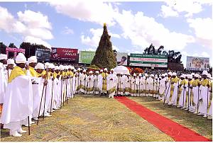
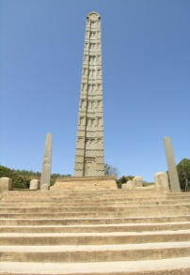
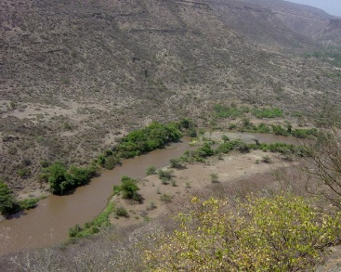
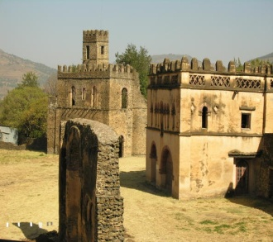
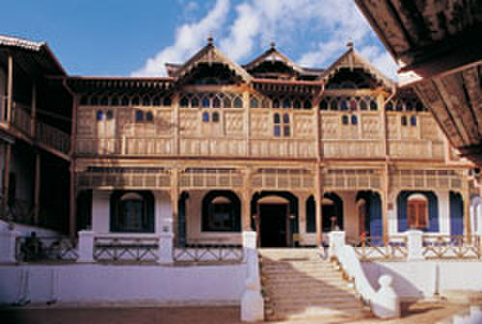
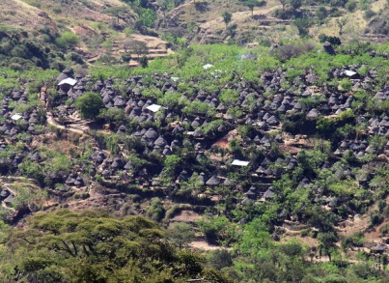
CONTEXTUAL REVIEW
CONTEXTUAL REVIEW
  Ethiopia and its Heritage
  Ten tangible heritages on World Heritage list
  Three tangible heritages on World Heritage list
  Six tentative lists to be inscribed as WH

Slide 24
No | Descriptions | Year of request
1 | Bale Mountains National Park | 2008
2 | Dirre Sheik Hussein Religious, Cultural and Historical Site | 2011
3 | Holqa Sof Omar: Natural and Cultural Heritage (Sof Omar: Caves of Mystery) | 211
4 | Gedeo Mixed Cultural and Natural Landscape | 2012
5 | Melka Kunture and Bachilt Archaeological Site | 2012
6 | Sacred Landscapes of Tigray | 2018

Slide 25
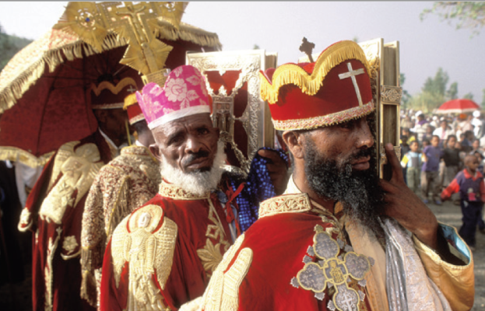
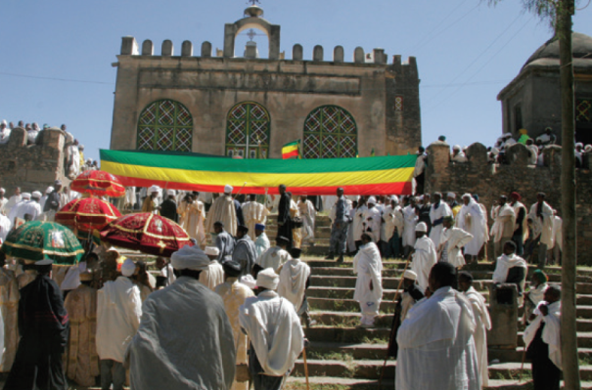
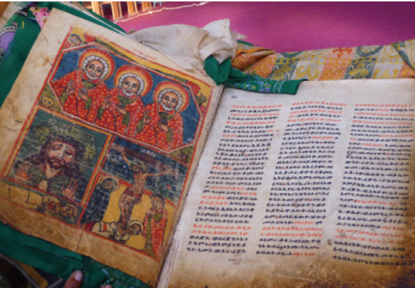
  The Ethiopia Orthodox Tewahdo Church
  Christianity is introduced to Ethiopia in the first decades AD
  EOTC is one of the oldest Christian churches in the world
  Top to Down chirstinizetion gave a chance for the church to be rich in heritage

Slide 26
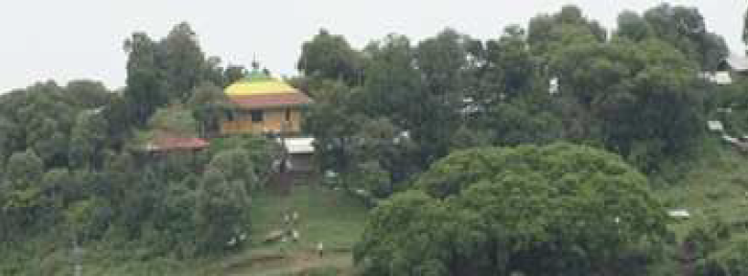
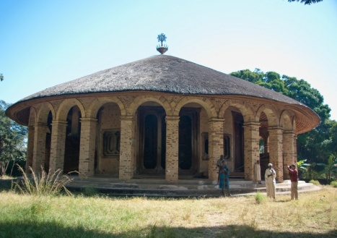
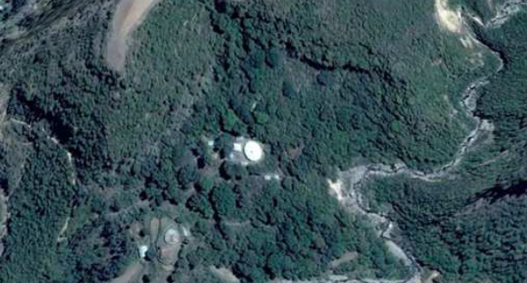
  EOTC Monasteries
  Christianity is introduced to Ethiopia in the first decades AD
  EOTC is one of the oldest Christian churches in the world
  Top to Down chirstinizetion gave a chance for the church to be rich in heritage

Slide 27
No | Name of the Saint | Place of Monastery | Date of commemoration (Ethiopian calendar)
1 | Abba Afse | Yeha | May 12
2 | Abba Alef | Bi’isa (at Mereb River) | March 11
3 | Abba Aregawi | Debre Damo | October 14
4 | Abba Gerima (aka Ishaq) | Adwa | June 17
5 | Abba Guba | Mudama | May 29
6 | Abba Liqanos | Aksum | November 21
7 | Abba Pentelewon | Aksum | October 6
8 | Abba Tsehima | Tsedenya | February 16
9 | Abba Yam’ata | Gere’alta | October 23

Slide 28
  Classification of EOTC monasteries
      Andinete Gedam (United Monasteries)
      Ye Qurit Gedam (Qurit Monastery)
      Ye Kahnat Gedam (Monastery of priests)
      Mezba’e and Debre Hazelo (Vacant monasteries)

Slide 29
  EOTC Tradition of conservation
    Spiritual reasons
          Gedil, Rituals, Tebel and Tsebel
    Cultural and educational reasons
          Market, Social gathering , education…
    Political (Power) Legitimacy
    Historic reasons
          National archive,

Slide 30
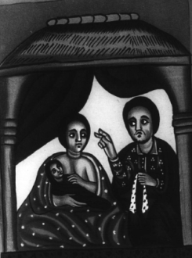
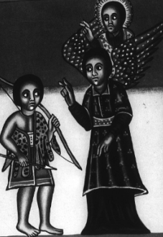
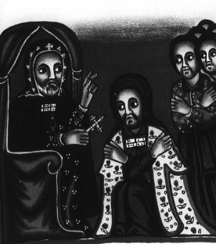
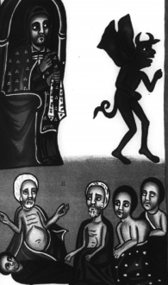
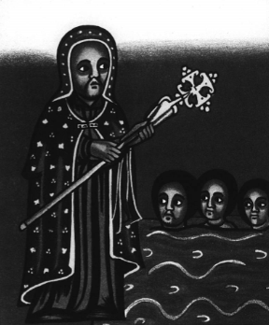
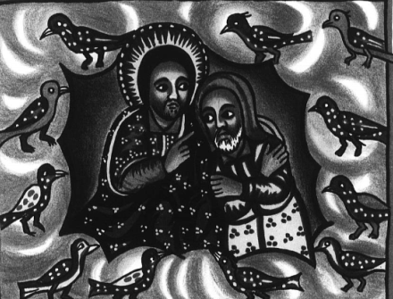
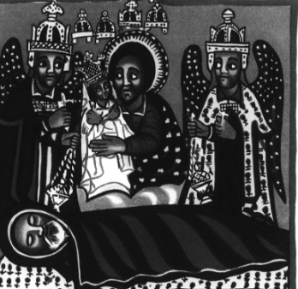
THE CASE OF DEBRELIBANOS
Hagiographies of Abune Teklehaimanot
Aferbayne version (EMML 2408)
Daga Estifanos version
Debre Libanos monastery version
Endode version (EMML 2782)
Gedembe version (EMML 7636)
Haiq Estifanos monastery version
Mescha version (EMML 2582)
Wallis Budge version (EMML 805)
Yohannes Kema version (EMML 806)

Slide 31
Additional Sources of Information
Sinkisar (Synaxarium)
Chronicles of Kings
Prayer Books
Hymn Books
Other Hagiographies
ዜና ልደቱ ለተክለ ሃይማኖት
መጽሐፈ ፍልሰተ ሥጋሁ
መጽሐፈ ተአምር
ብዕለ ነገሥት፡-
ልደተ አበው

Slide 32
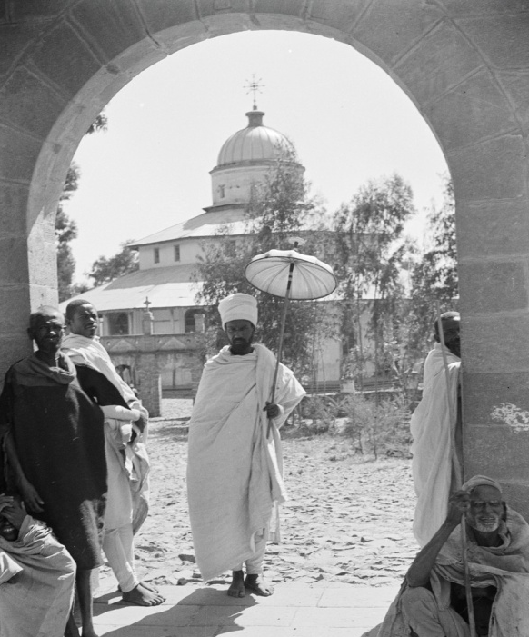
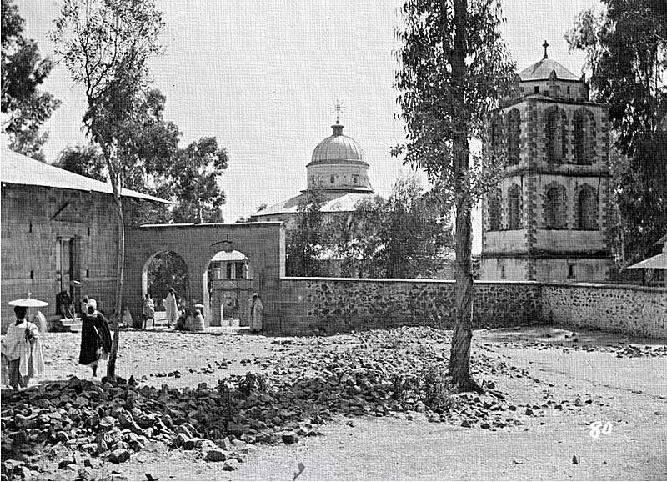
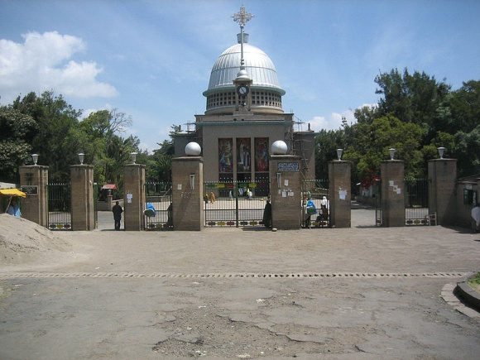
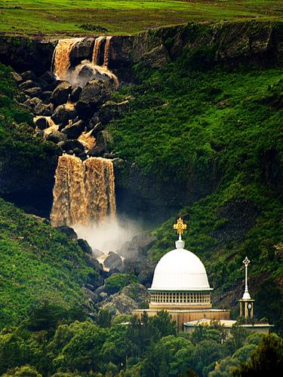
CONTEXTUAL REVIEW
THE CASE OF DEBRELIBANOS
  Aba Libanos
  Abune Tekle Haimanot
  Debere Asbo
Debre Libanos

Slide 33
      “Debir”, “Minet”, and “Mekan”.
DEBIR
  Literally it means mountain
  Symbolically represents holy or sacred place or church
  Its value is derived from followers
MINET
MEKAN
  Literally it means place
  Its value is believed to be divine or historic blessing

Slide 34
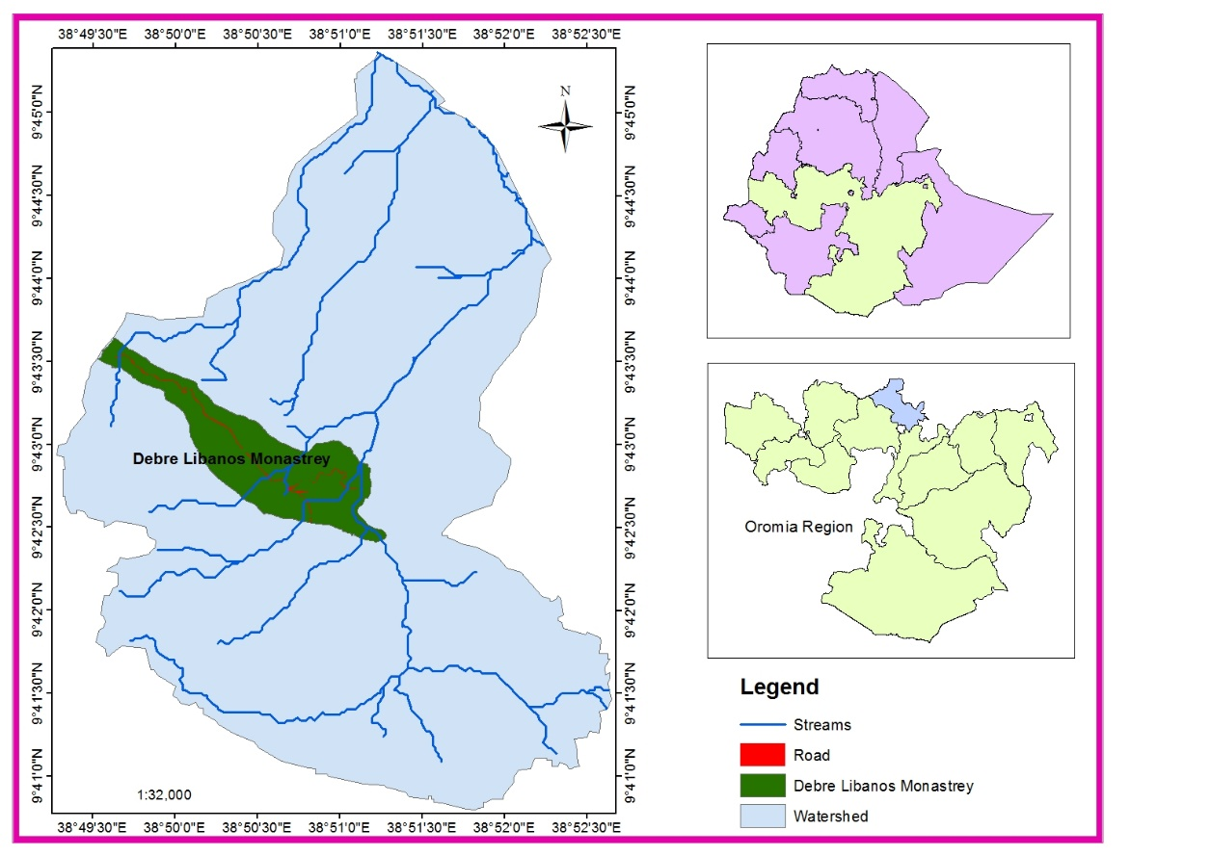
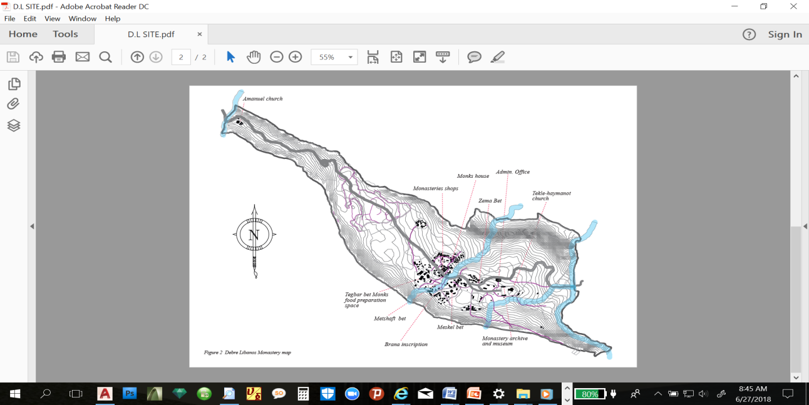
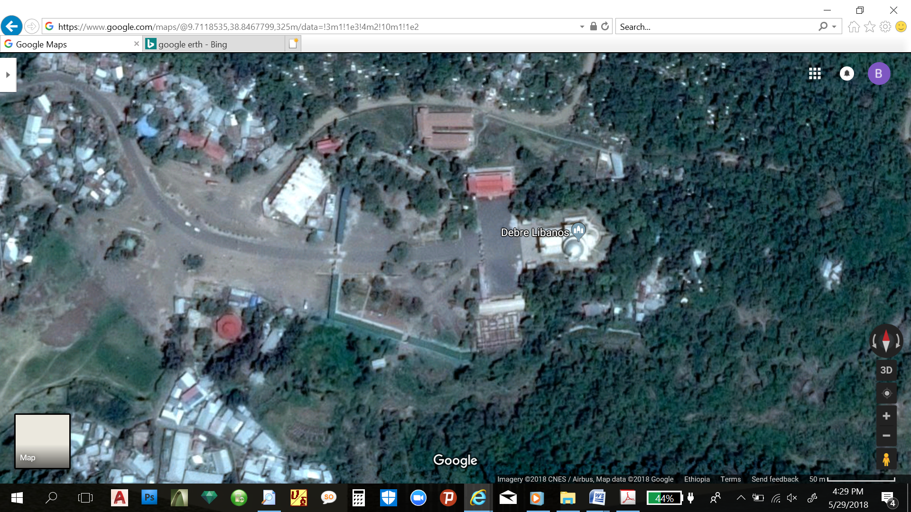
Location
  104 km from Addis Ababa
  North Shewa Zone of Oromia
  located at 2400 m altitude
  geographical location is 38051’E and 09041’ N

Slide 35
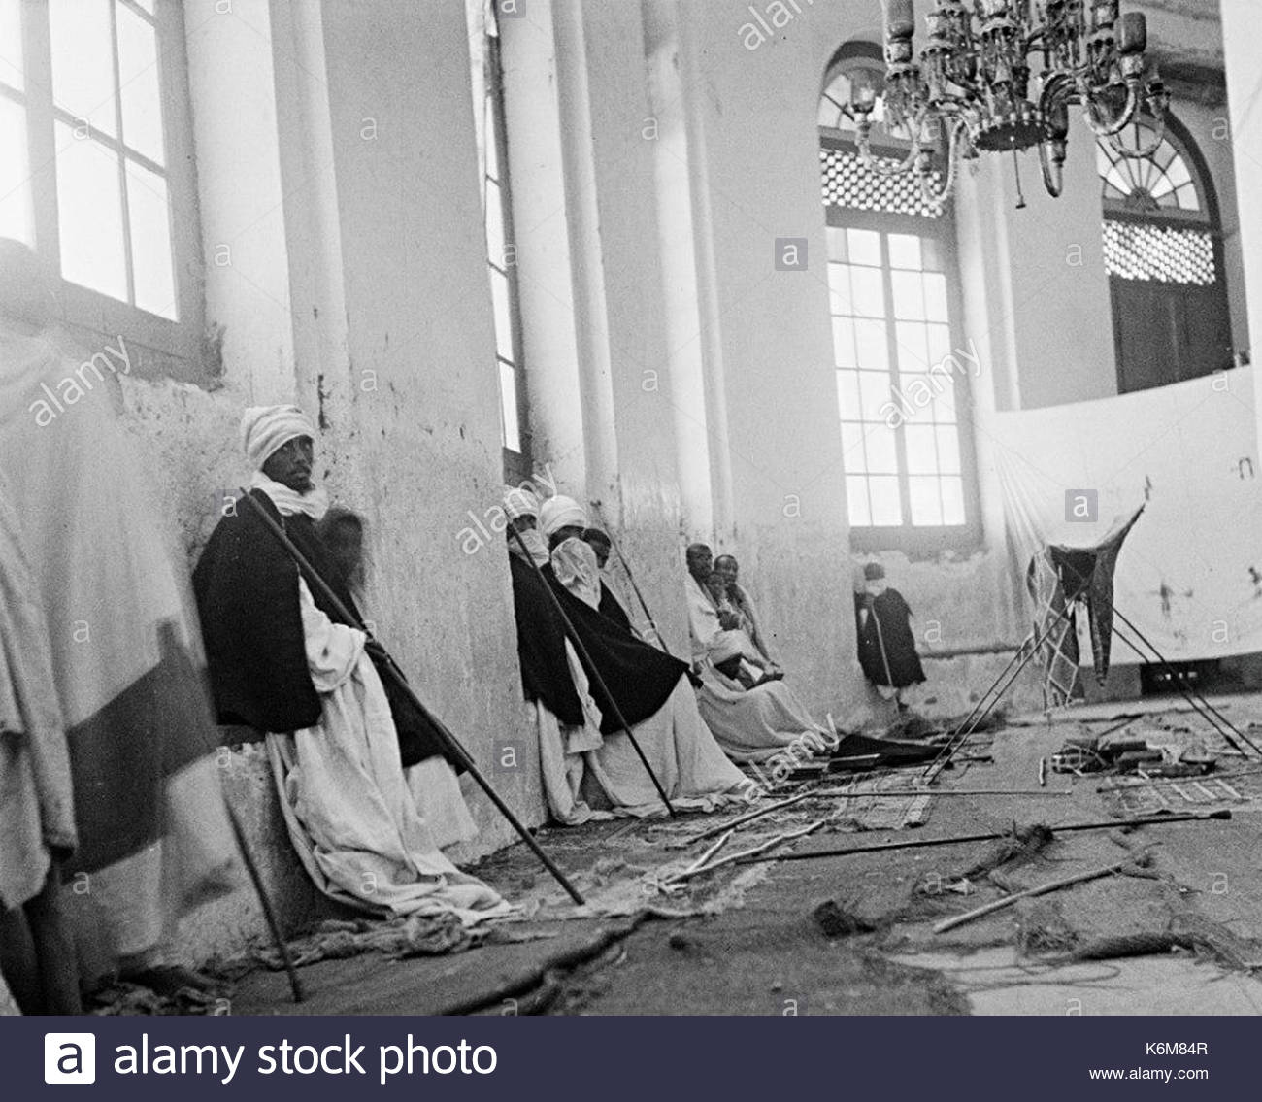
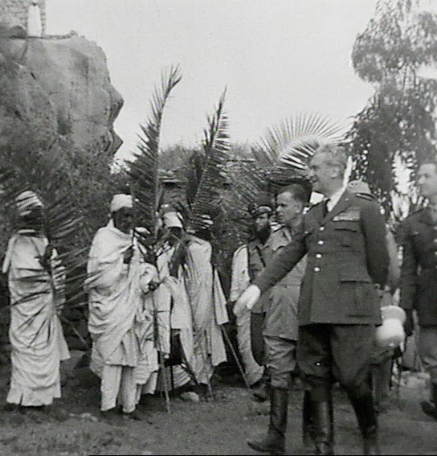
The Church of Abune Tekle Haimanot was rebuilt several times
From Yikuno Amlak to Haileselasie (the existing Church)
Ahmed Giragn and Italian invasion time the church was destroyed
Reconstructed around the site but with different designs
The above is constructed by King Minilik II

Slide 36
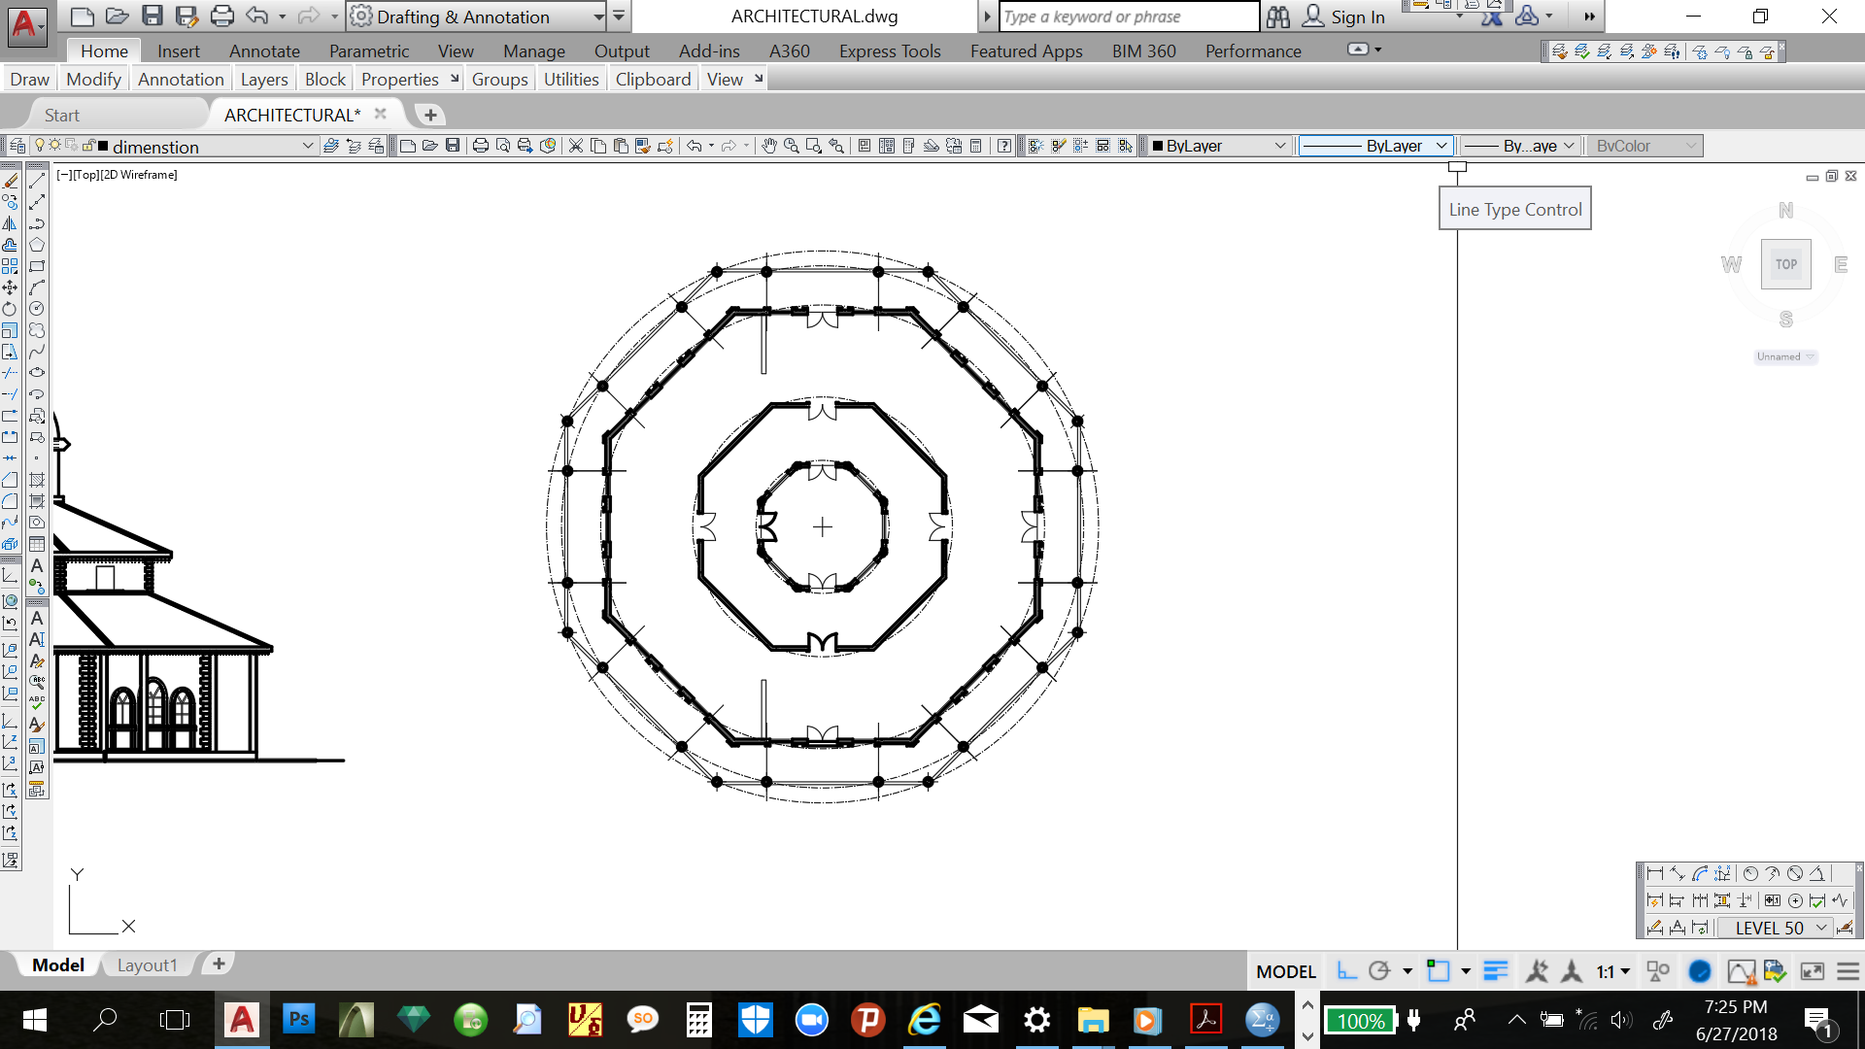
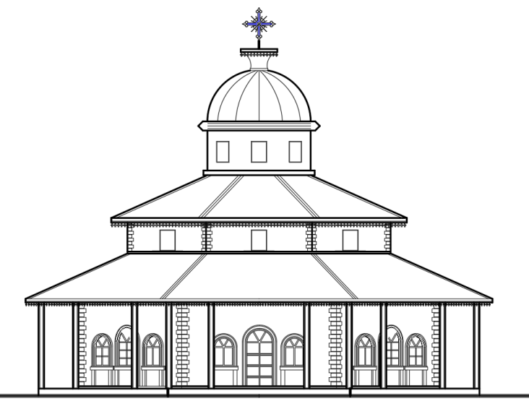
From historical manuscripts and picture analysis Architectural style of the church reconstructed by Emperor minilik seems Entoto Raguel
Some Sources argue Emperor Yohannes reconstructed the church with 18 domes.
The surrounding site changed dynamically with new constructions.

Slide 37
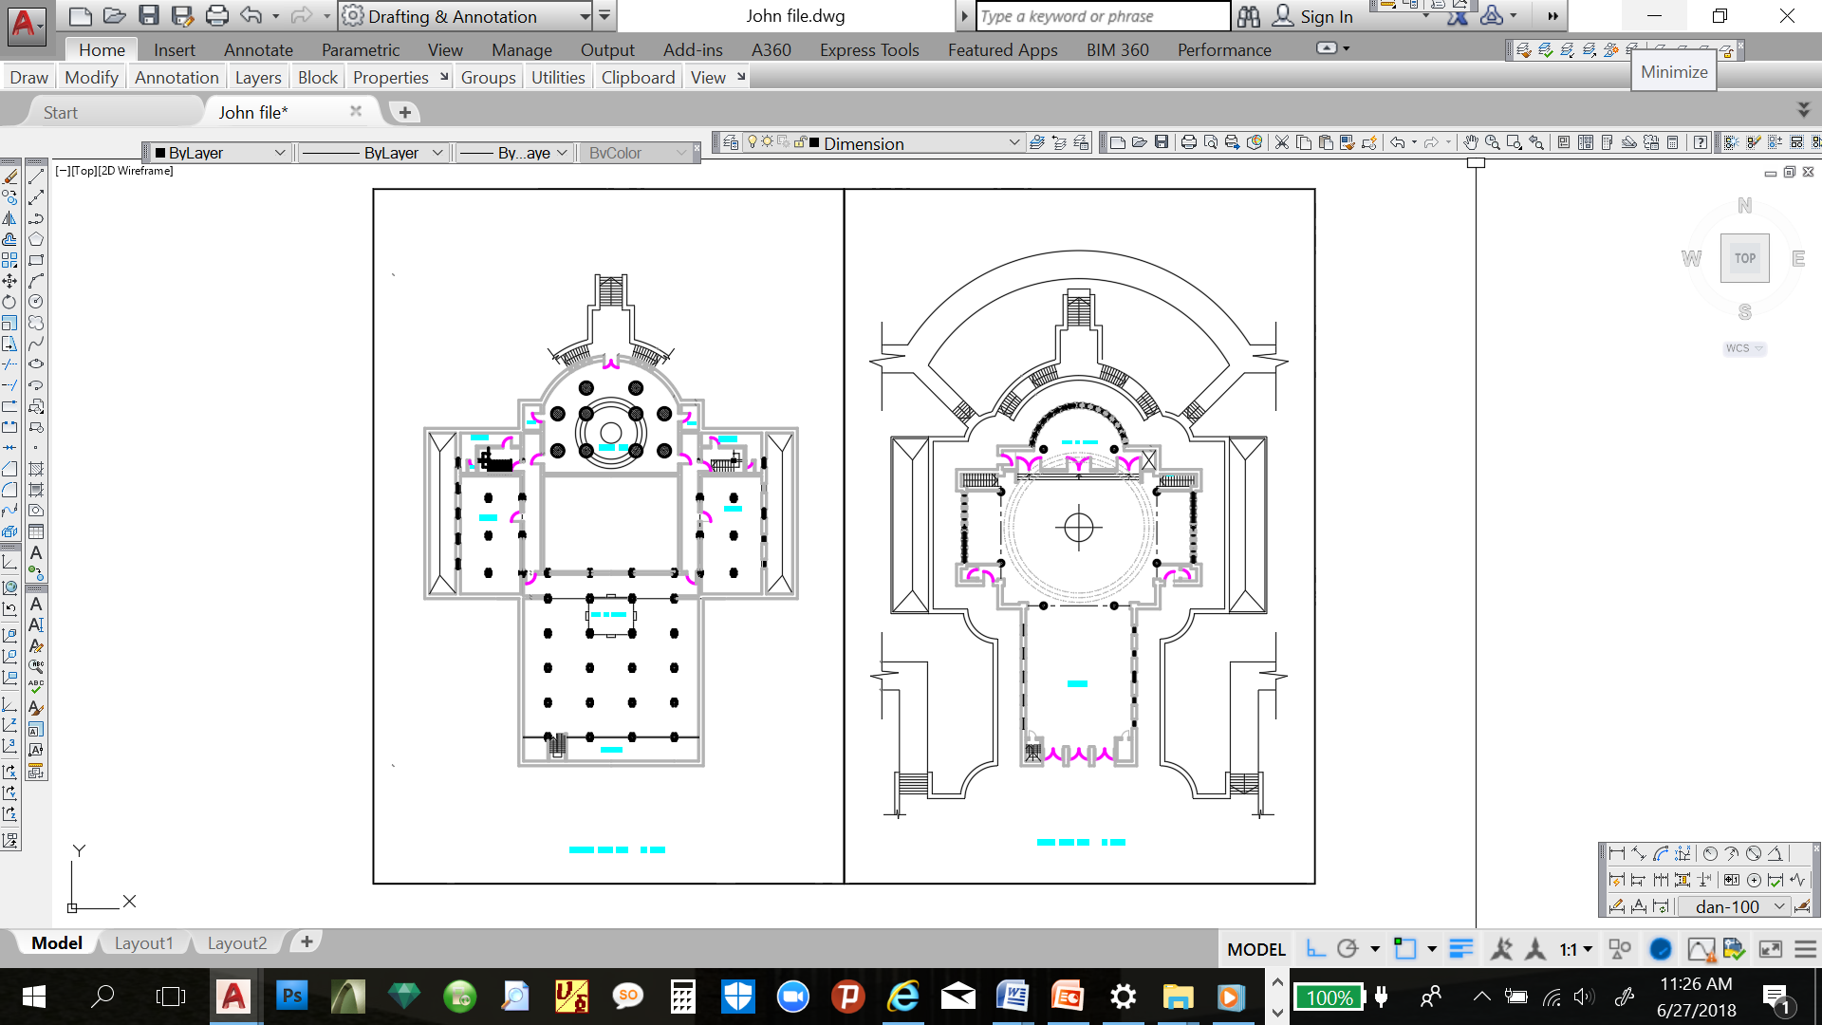
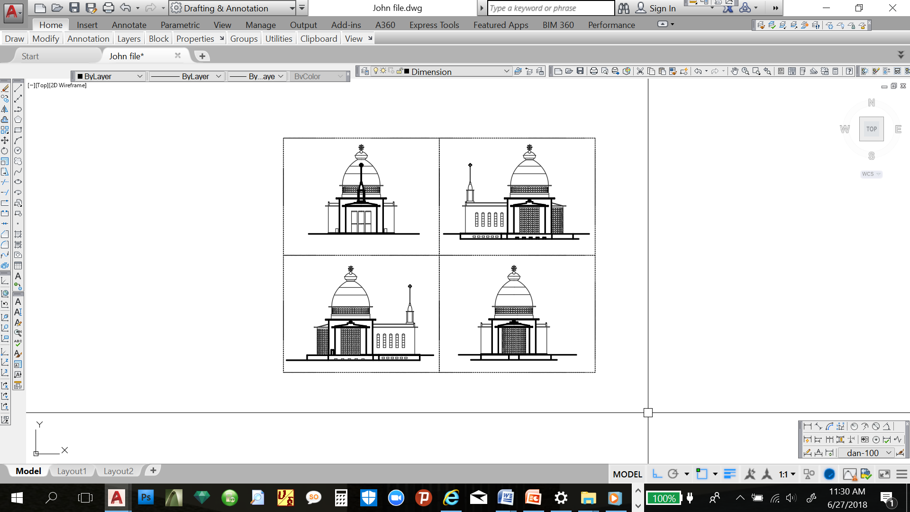
As built of existing church constructed by emperor Haileselasie.
During excavation, treasures were found including gold ring of King Minilik II to king Haileselasie.
Monks were advised the king to preserve the previous church constructed by king Minilik. However others advised adversely.

Slide 38
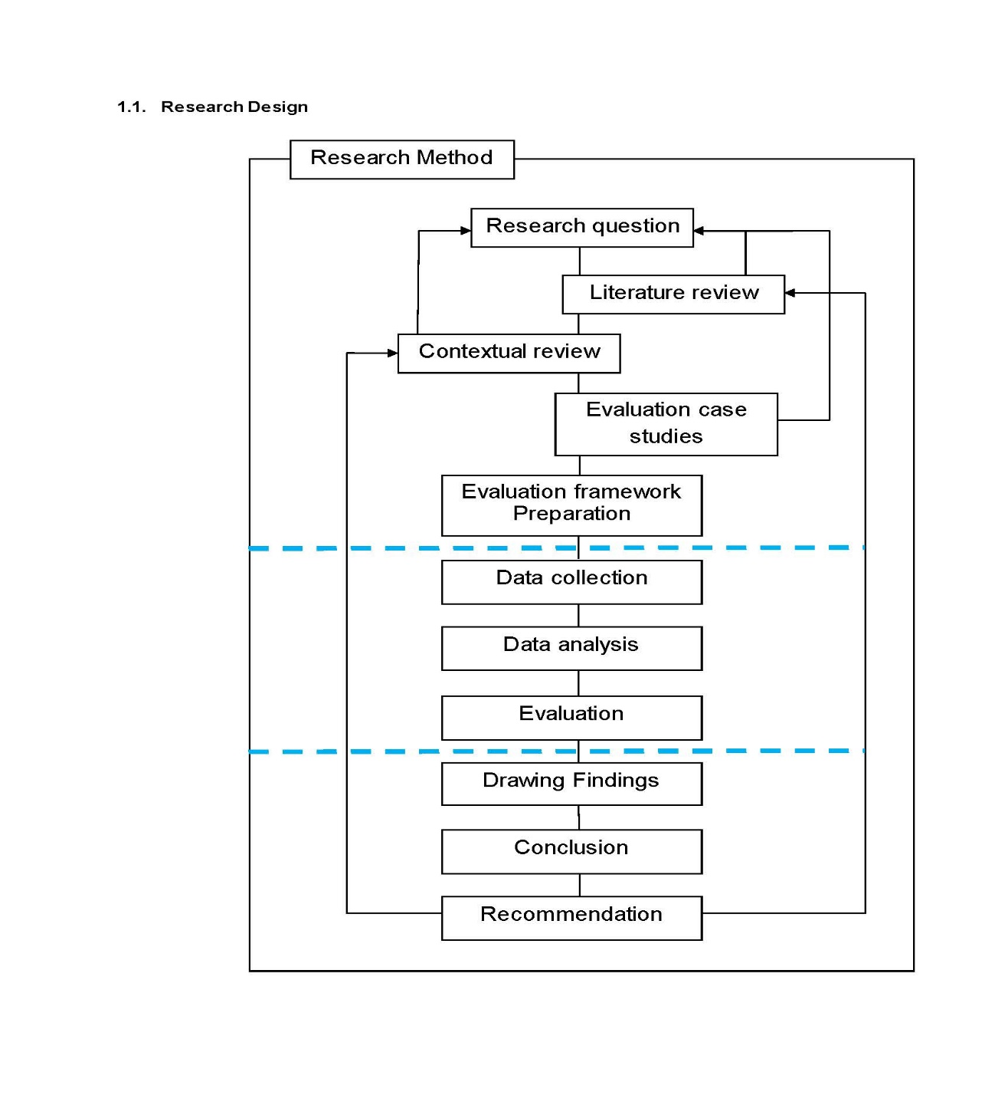
  RESEARCH METHEDIOLOGY
General approach, purposive data collection system
Primary data was collected through a structured questioner and
purposive interview was conducted
Secondary data were also analyzed
On site assessments were done
Research diagram

Slide 39
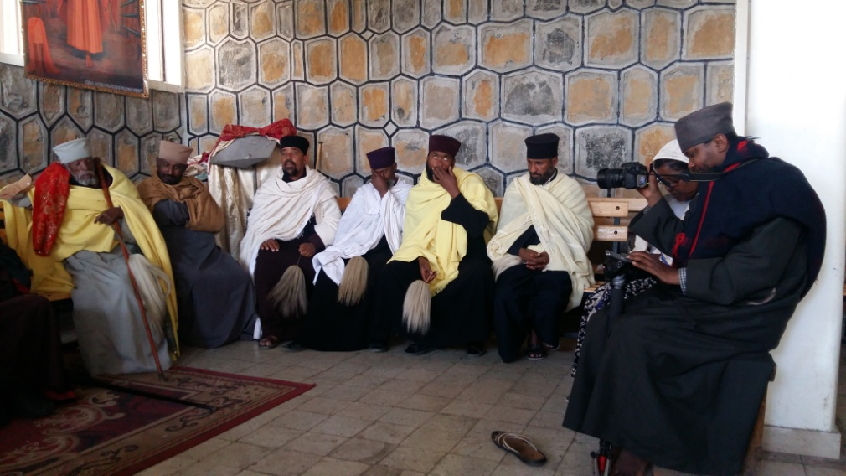
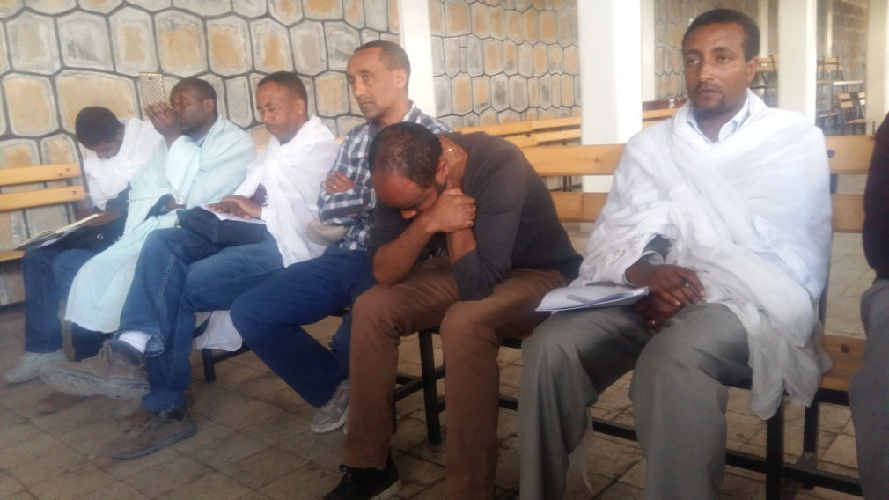
Research Methodology contd
  Primary Data collection through questionnaire and interview
  Church Fathers and church scholars who are actively participating in church management.
  Architects and Engineers who have been working on church design and informal conservation

Slide 40
Research Methodology contd
  STUDY AREA
Addis Ababa
  Sewasiwe Birhan St Pawlos spritual school (Students and teachers of holy scripture)
  Bete Kihnet (sit of Holy Synod)
  Professionals working as consultants
Debrelibanos
  Monastery (Monks)
  Abnet students

Slide 41
Research Methodology contd
  Questionnaire and response rate
The total numbers of questionnaires distributed = 67
The total numbers of questionnaires returned = 58
The total numbers of valid questionnaires = 58
  22 questionnaire distributed for Professionals and 17 were returned
  15 questionnaire distributed for folowers and 10 were returned
  30 questionnaire distributed for Clergy men and 27 were returned.

Slide 42
  FINDINGS AND DISCUSSION
Demography of the respondents
All the collected questionnaires were valid and response rate is 86.6%.
Of the total respondents 18 (31%) were professionals
Twenty-eight (48.3%) were clergy men who are directly involved on heritage conservation and primary owners of the site.
Majority (63.8%) of the respondents are in the age group of 30-50.
educational background perspective, 35 (60.3%) of the participants have first degree and above
Majority of them have exposure on church teachings are 93.1%.
Majority (56.9 %) of them have served the church more than 10 years.

Slide 43
Findings and discussion contd… …
Respondents previous exposure
and participation on church conservation projects
 |  | Frequency | Percent
Respondents Role | Committee member | 21 | 36.2 %
 | Chairman | 9 | 15.5 %
 | Consultant | 26 | 44.8 %
 | Contractor | 1 | 1.7 %
 | other | 1 | 1.7 %
 | Total | 58 | 100.0

Slide 44
Findings and discussion contd… …
Respondents reflection on
monastic site selection criterion
 |  | Site selection criterion
 |  | Convenient place for pilgrims | Silent place for prayer and spiritual services | Other
Professional contribution | Architects and Engineers | 1 | 16 | 1
 |  | 5.6% | 88.9% | 5.6%
 | Cleargy Men of EOTC | 9 | 19 | 0
 |  | 32.1% | 67.9% | 0.0%
 | Followers of EOTC | 3 | 8 | 1
 |  | 25.0% | 66.7% | 8.3%
Total |  | 13 | 43 | 2
 |  | 22.4% | 74.1% | 3.4%

Slide 45
Findings and discussion contd… …
Respondents reflection on the look of new conservation design

Slide 46
Findings and discussion contd… …
Respondents reflection on
the use of construction material for conservation
 |  | What construction material to use for conservation project
 |  | Exactly the same as the previous construction material | Better and modern construction material different from the previous one | Other
Professional contribution | Architects and Engineers | 33.30% | 61.10% | 5.60%
 | Clergy Men of EOTC | 39.30% | 50.00% | 10.70%
 | Followers of EOTC | 16.70% | 50.00% | 33.30%

Slide 47
Findings and discussion contd… …
Respondents answer for
Reconstruction site (Position in reference to the original site)
 |  | In case of reconstruction relocation site
 |  | Exactly on the original site | Nearby site from the original location | It's okay to take it far if the site is more convenient
Professional contribution | Architects and Engineers | 33.30% | 50.00% | 16.70%
 | Clergy Men of EOTC | 57.10% | 17.90% | 25.00%
 | Followers of EOTC | 75.00% | 25.00% | 0.00%
Total |  | 53.40% | 29.30% | 17.20%

Slide 48
Findings and discussion contd… …
“…ሰብእ ይቄድሶ ለመካን
መካን ይቄድሶ ለሰብእ… ”
“Man Cleanthes a Place
And the Place Cleanthes man”
“We shape our environment and
Our environment shapes us …” W. Churchil

Slide 49
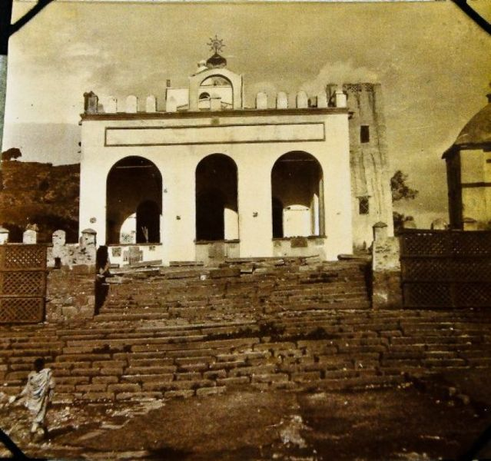
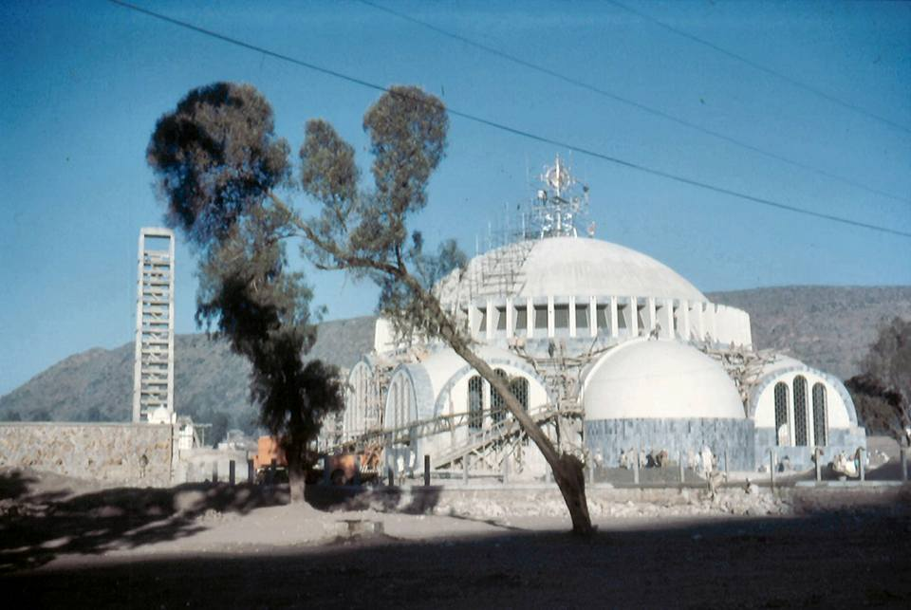
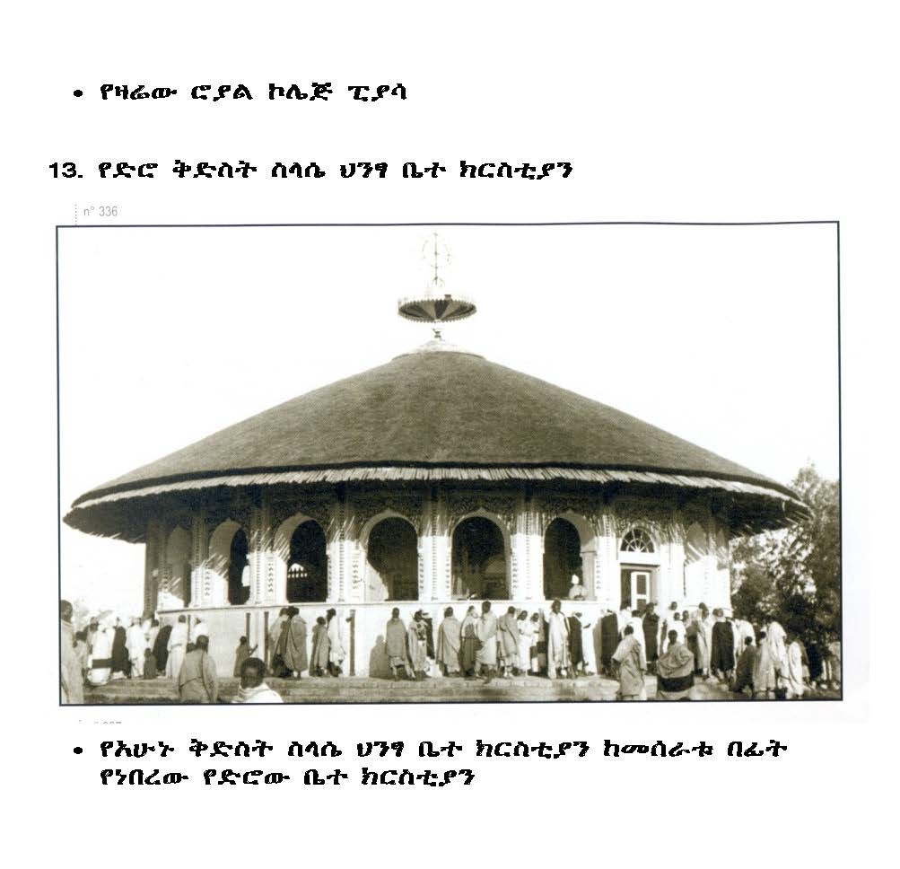
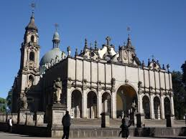
Findings and discussion contd… …

Slide 50
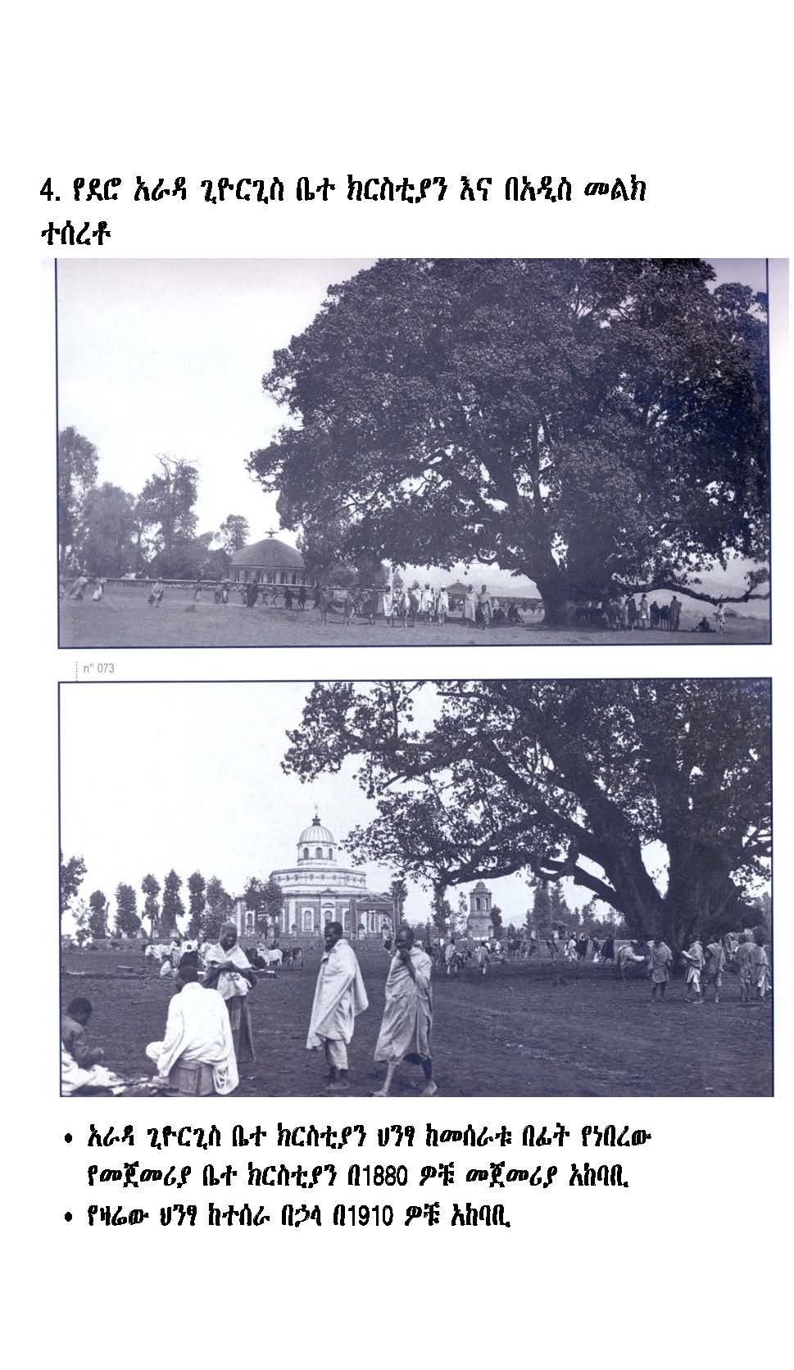
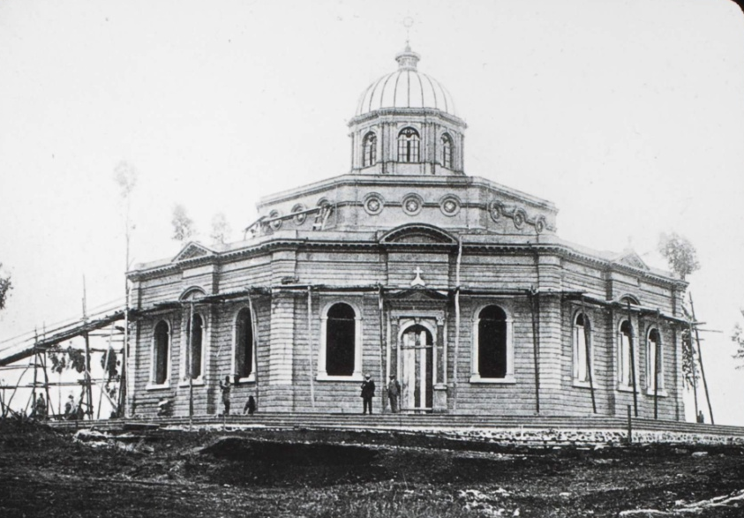
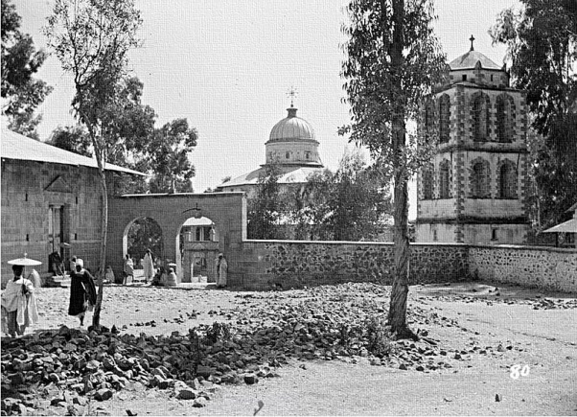
Findings and discussion contd… …

Slide 51
  Conclusion and Recommendations
EOTC conservation tradition is neither similar with the western which deals with conservation of the object and aesthetics nor the eastern tradition which deals with the conservation of subject “
What is conserved in the case of EOTC is
  the legacy of the place
  Spirit of the place
  Continuity of the spiritual service

Slide 52
Conclusion and recommendations contd…
From the finding the researcher observed the gap between stockholders in understanding the underplaying values and conservation principles of EOTC.
Thus, value mapping and awareness creation is vital to fill the gap and enhance the conservation of spiritual dimension for our living heritages
International Community
Government
Educational Institutes
EOTC

Slide 53
Thank You

